Slide 1
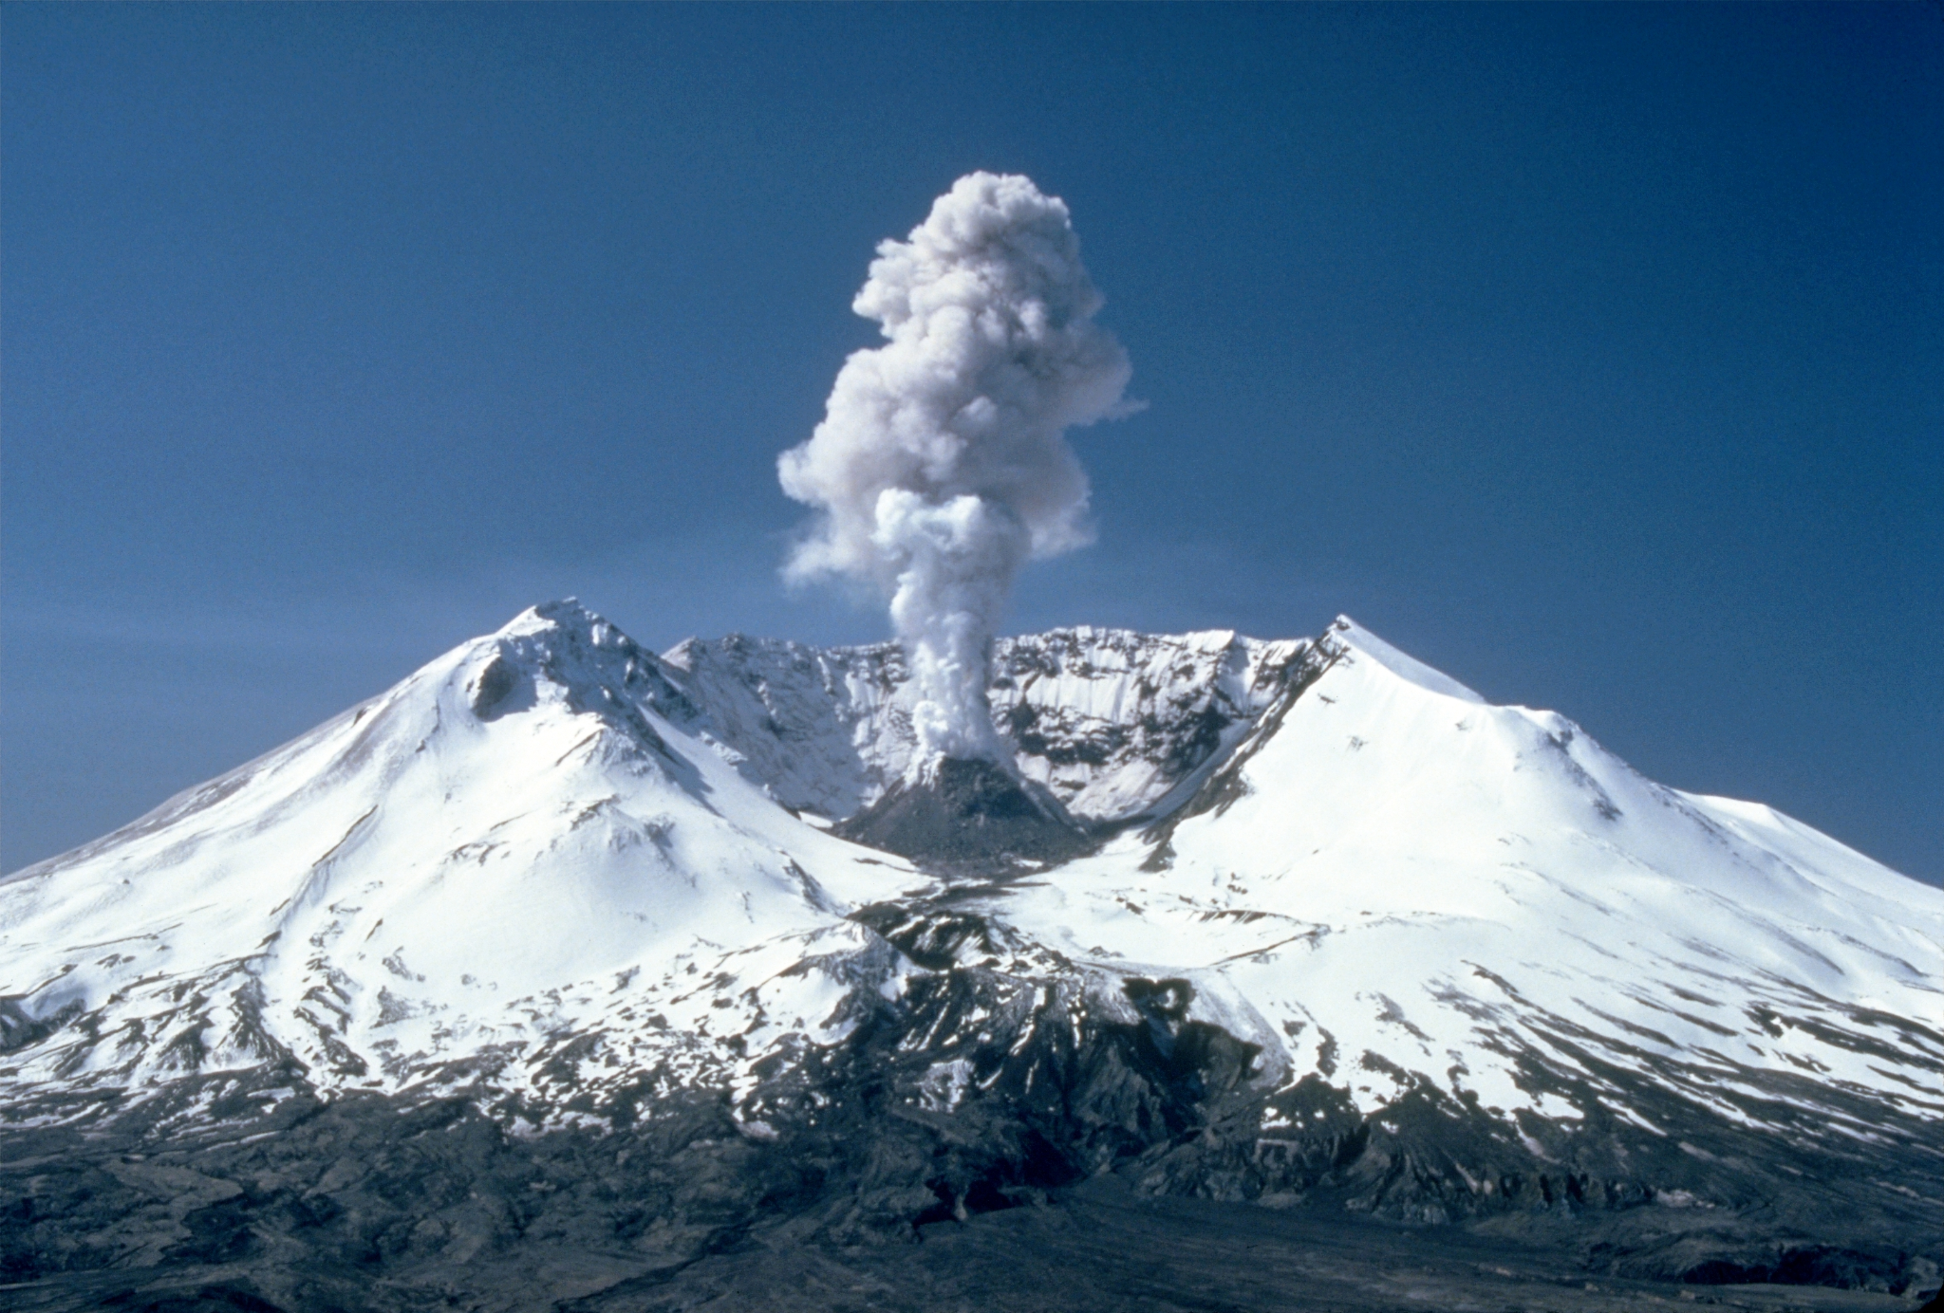
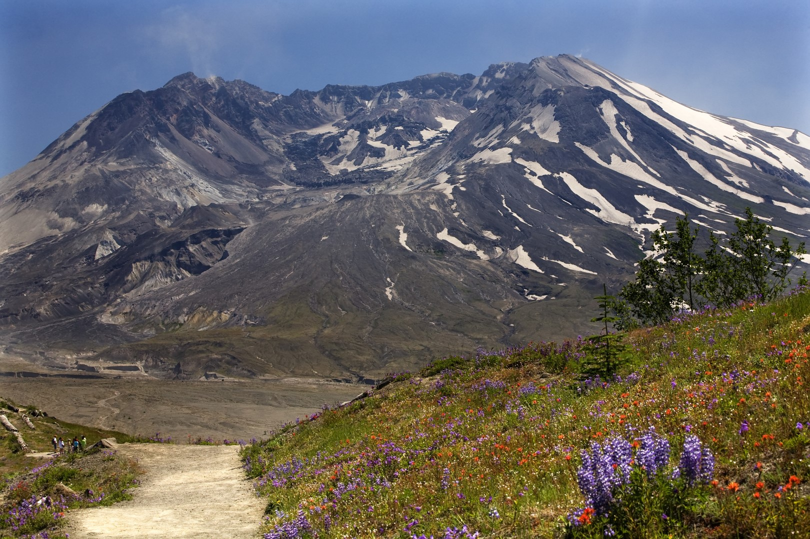
Boom & Bloom: Multi-year Comparison of Species Composition Due to Abies procera Influence on Mt. St. Helen’s Pumice Plains
Presented by: Ada de la Cruz
In collaboration with: Katey Queen, Alex Watcher, Isabel Rodriguez, and Dr. Cynthia Chang
Department of Biological Sciences, School of STEM (University of Washington, Bothell)
Mount St. Helens - Wikipedia
Mt. St. Helens, Before and After Photos and Maps - TopoZone

